Slide 1
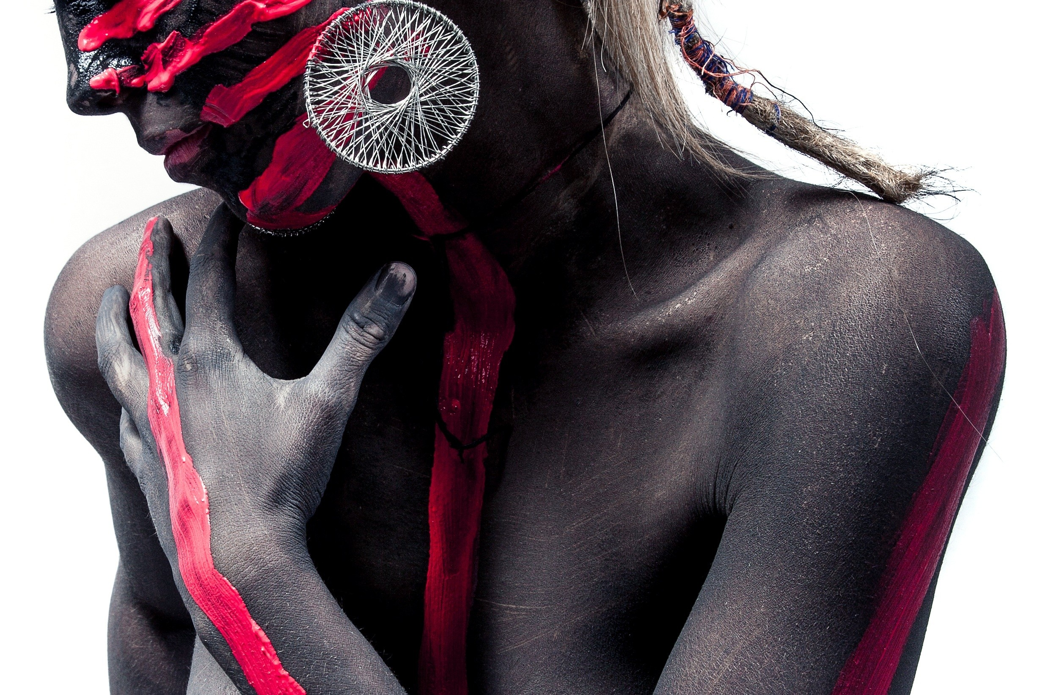
A NEW CREATIVE STUDIO
GOOD DESIGN IS ALWAYS IN SEASON
There are moments in life when you miss someone so much that you just want to pick them from your dreams and hug them for real! Dream what you want to dream;

Slide 2

DESIGNED BY NIGHT
BUSINESS
SUMMERISE REPORT
POWERPOINT

Slide 3

ANT
BLACK
Designed by Night
BUSINESS REPORT
There are moments in life when you miss someone so much that you just want to pick them from your dreams and hug them for real!
More creation
More creation

Slide 4

Designed by Night
You can attract me though weibo
Designed by Night
THE SLIDE
02
Little title
Little title
Little title
Little title

Slide 5

BUSINESS
SUMMERISE REPORT
POWERPOINT
WORKING WITH YOUR FAVORITE TRAINERS
ANYWHERE , ANYTIME
ANTTIME
ANYWHERE >

Slide 6

Ant Black
Just another power point by Night
Start

Slide 7

Ant Black
DISCOVERY
UNITED KINGDOM

Slide 8

RISEN
DESIGNED BY NIGHT
There are moments in life when you miss someone so much that you just want to pick them from your dreams and hug them for real!

Slide 9
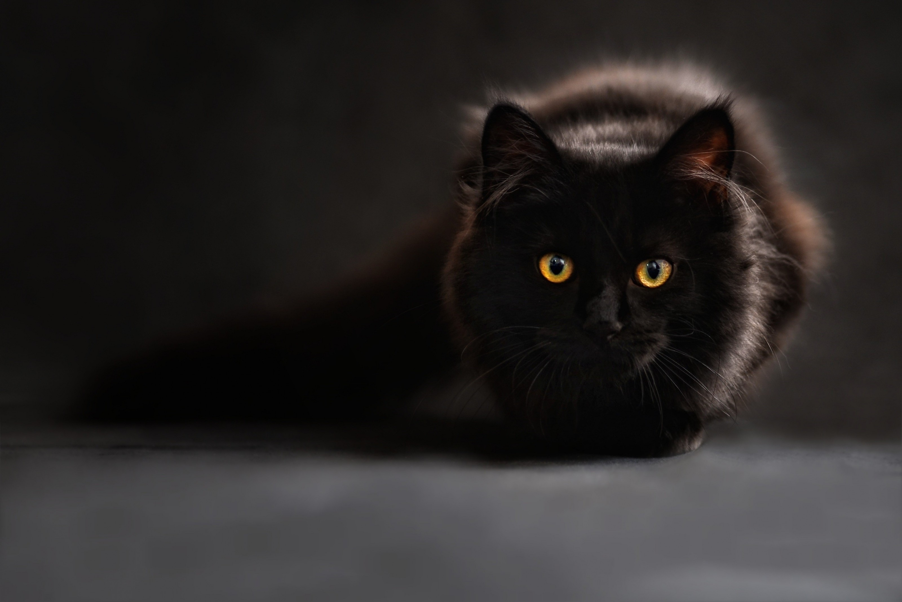
STRONGER & STRONGER
EVERYDAY
There are moments in life when you miss someone so much that you just want to pick them from your dreams and hug them for real! Dream what you want to dream;
TO BE STRONGER

Slide 10
To see a world in a grain of sand, And a heaven in a wild flower
To see a world in a grain of sand
Ant Black
SUMMERISE
POWERPOINT

Slide 11


I’m
ThinkPad
Tablecomputer
I’MNOT
PAD
ThinkPad
Understand the business tools
There are moments in life when you miss someone so much that you just want to pick them from your dreams and hug them for real!

Slide 12

CROSS
THE REDESIGN
There are moments in life when you miss someone so much that you just want to pick them from your dreams and hug them for real! Dream what you want to dream;

Slide 13

BUSINESS
SUMMARISE REPORT
Just another powerpoint
JUST DO IT

Slide 14

Business PowerPoint
Designed by Night

Slide 15

Careers
There are moments in life when you miss someone so much that you just
There are moments in life when you miss someone so much that you just want to pick them from your dreams and hug them for real! Dream what you want to dream;

